Slide 1
SYLLOGISM
The Art Of Logical Thinking…
By- Sakshi Tiwari

Slide 2
What is Syllogism?
In Syllogism we have the ‘Statements’ and the ‘Conclusions’
The challenge in to check whether the given conclusions are valid to the given statements or not
The best way to learn Syllogism is through the Venn Diagram

Slide 3
Types of Syllogism
1) Direct Syllogism
2) Reverse Syllogism
3) Coded Syllogism
4) X-Y Syllogism

Slide 4
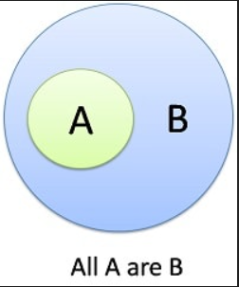
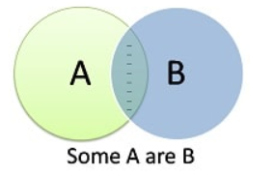
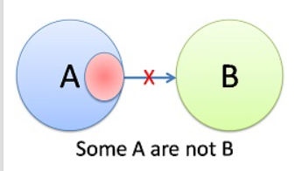
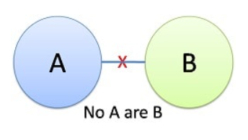
Cases of Statements
1) ALL 2) Some
3) Some Not 4) No

Slide 5
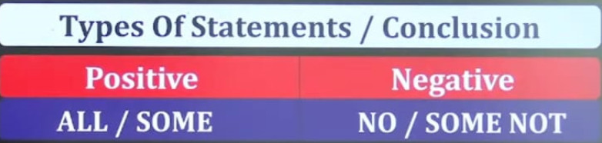
CONTINUEd…….
1) Possibility
2) Either
3) Only
4) Only Few

Slide 6
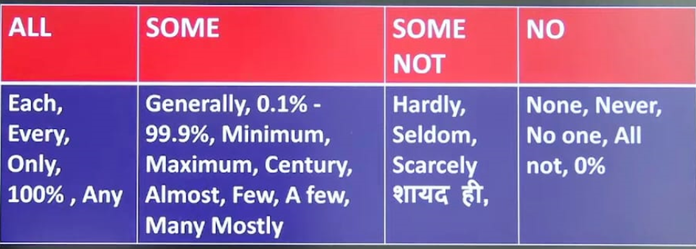
Some Important Keywords…..

Slide 7
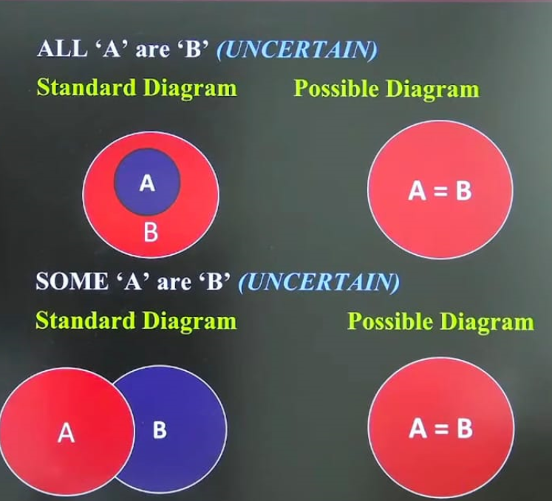
Certain and Uncertain….

Slide 8
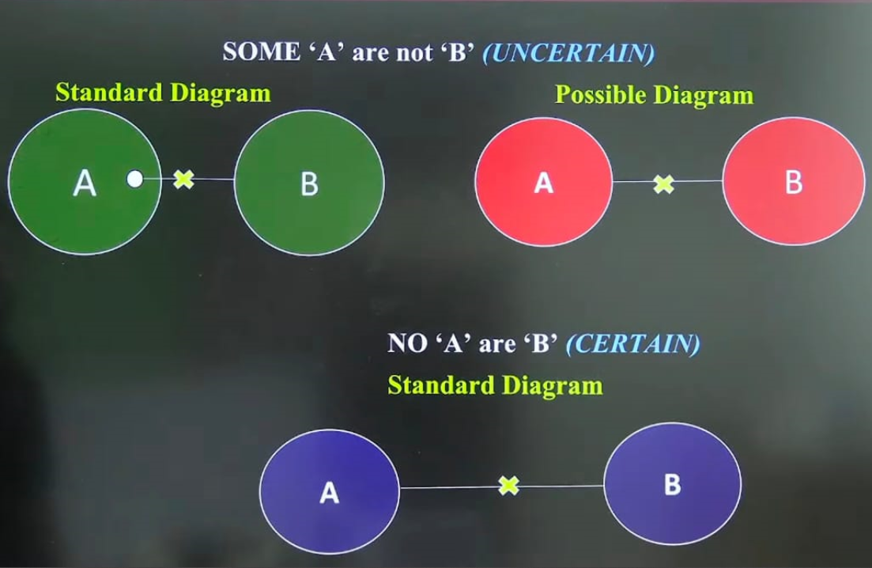
CONTINUed……

Slide 9
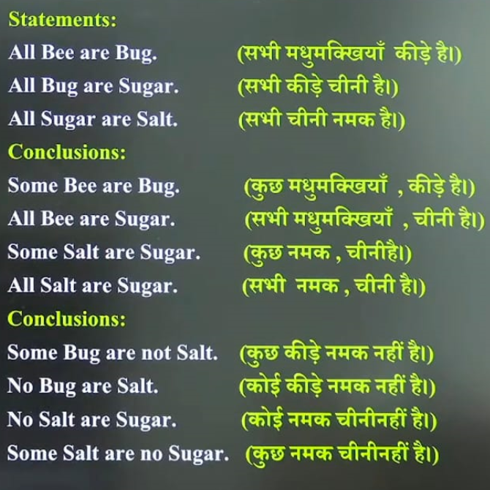
1) ALL CASE

Slide 10
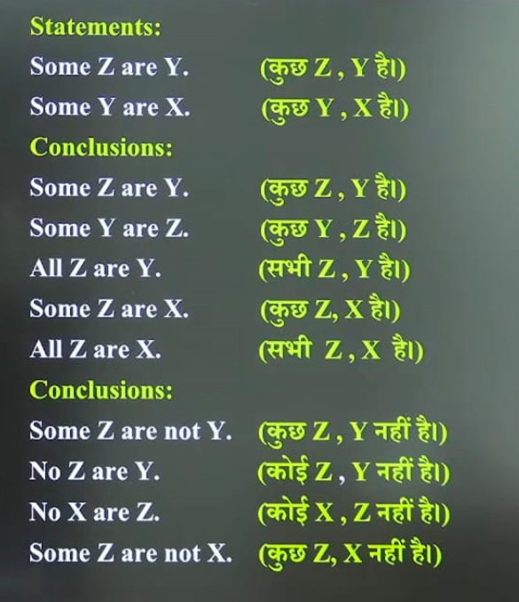
2) Some CasE

Slide 11
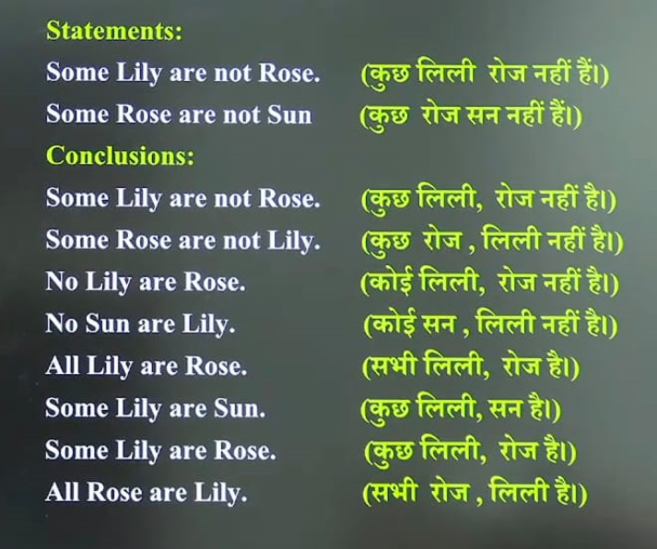
3) Some Not

Slide 12
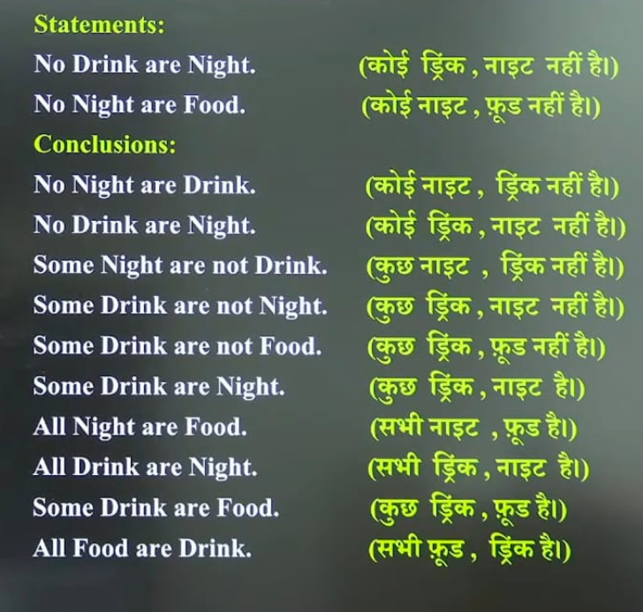
4) No CasE

Slide 13
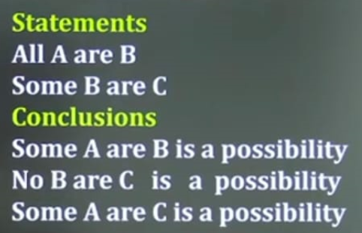
* Possibility

Slide 14
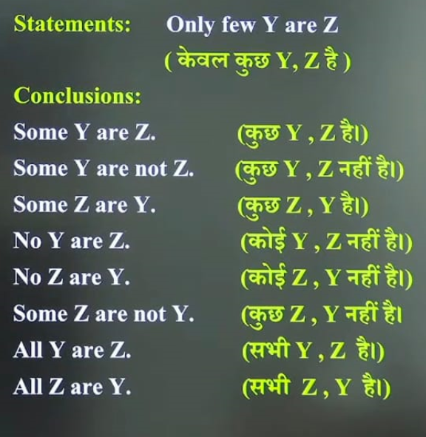
* Only few case / Only a few case Y->Z ( Some +Some not) [ ALWAYS TRUE] z->Y (some -----> true, some not-------> false)

Slide 15
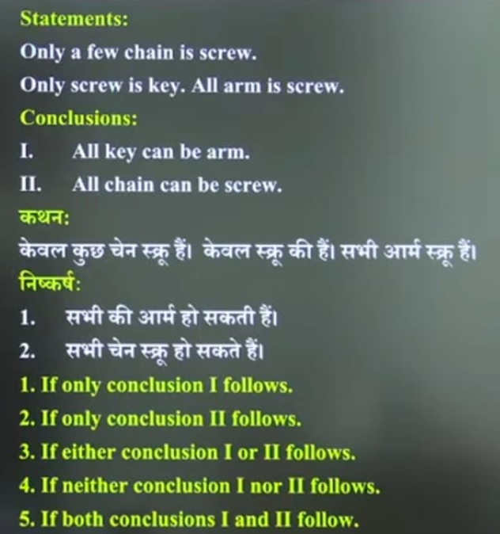
*Only Case

Slide 16
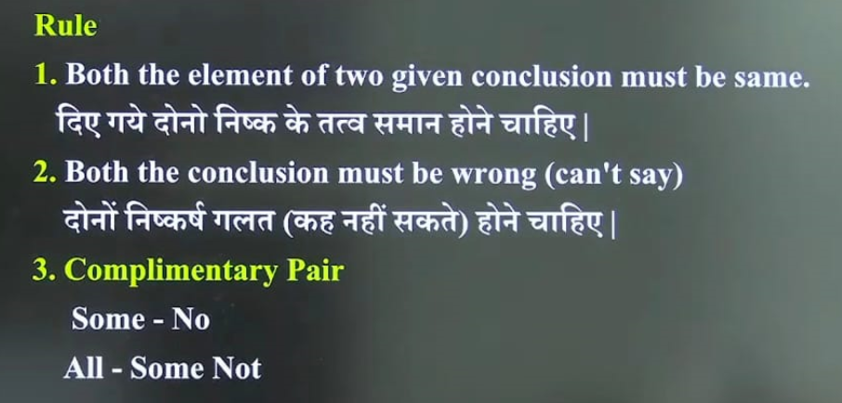
*Either OR

Slide 17
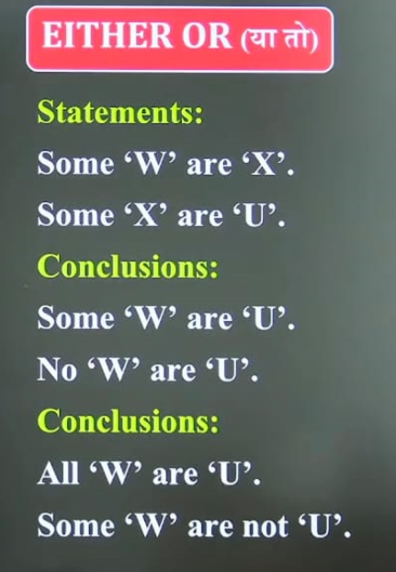
Continued……

Slide 18
THANKS

